Slide 1
Creating an Agency
Delivered as: CXAD-2868

Slide 2
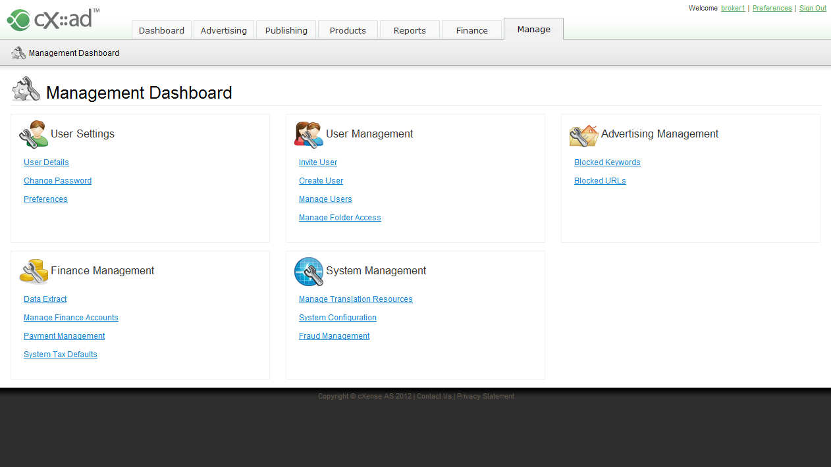
Create new User
Broker User Navigates to Manage > Create User

Slide 3
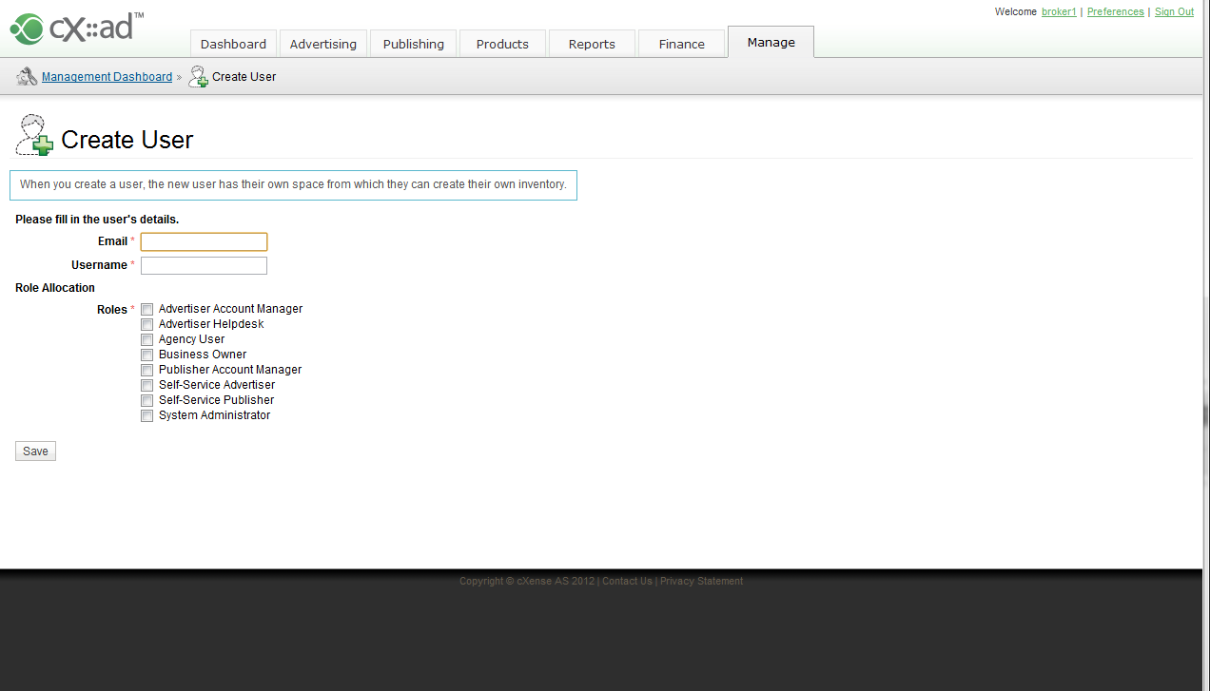
Creating a new Agency
Enter the Agency’s Name, or a particular representative’s name

Slide 4
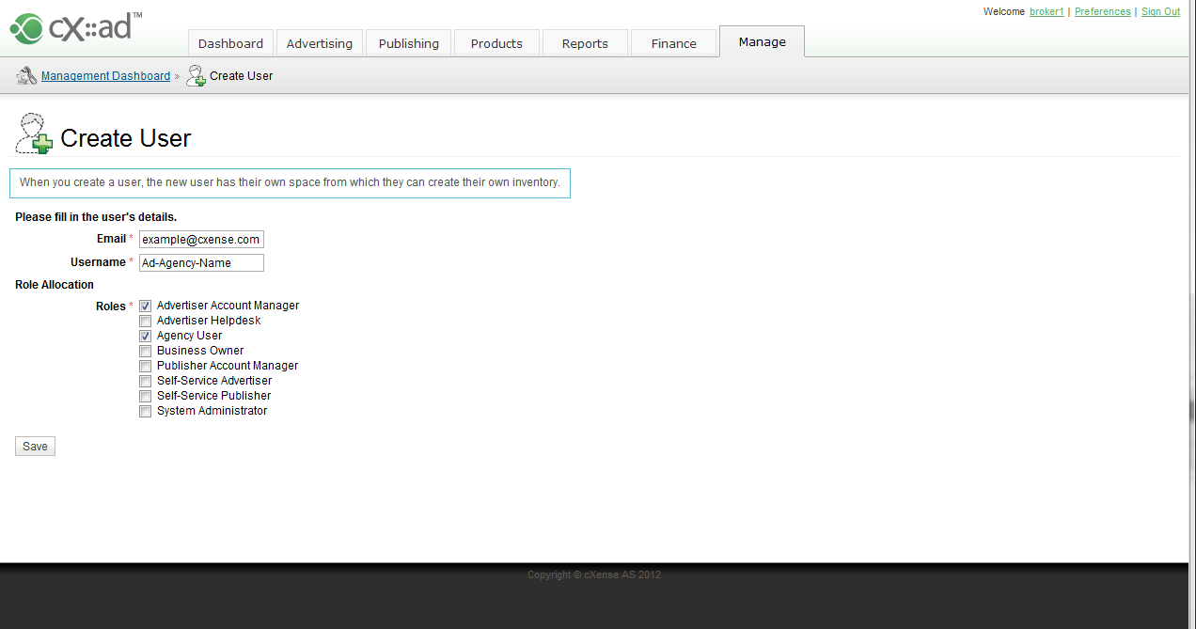
Creating a new Agency
2) Set the ‘Type’ of Agency by also selecting one of;
Advertising Account Manager
Publishing Account Manager
(Advertising agency shown here)
1) Select Agency User

Slide 5
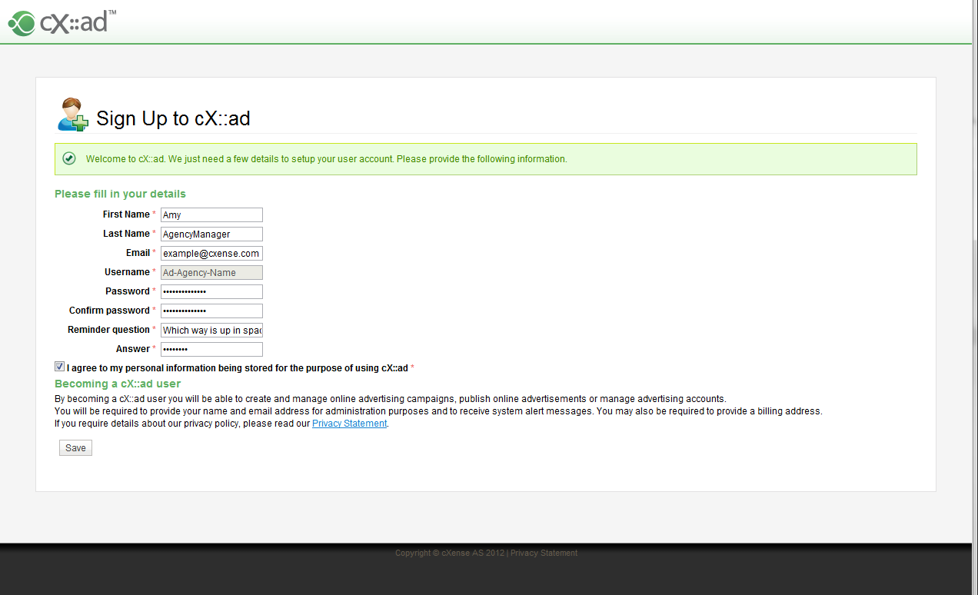
New Agency User
1) Agency User receives authentication email with URL
2) Agency User Clicks URL in their Email
3) Agency User fills in User Details

Slide 6
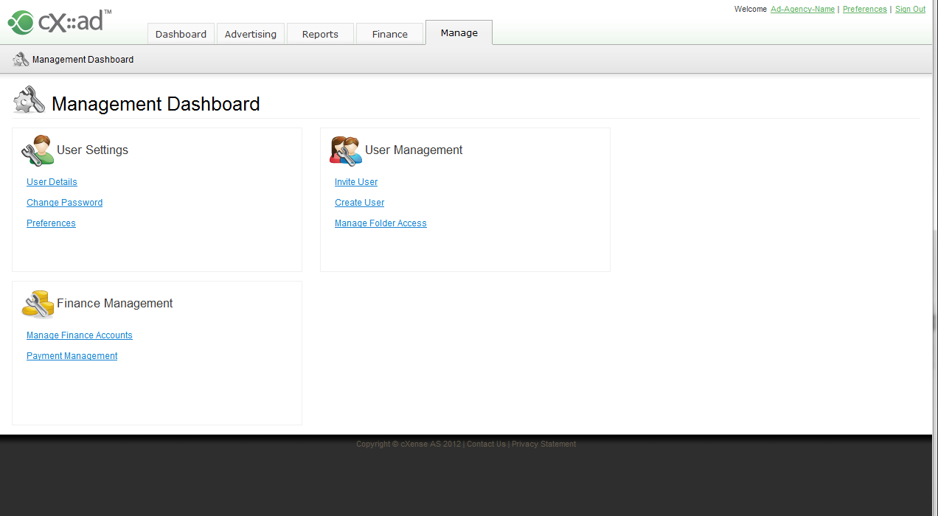
New Agency User can create
Customers / Clients
1) Agency User Can Create ‘Sub Groups’ or ‘Sub Networks’

Slide 7
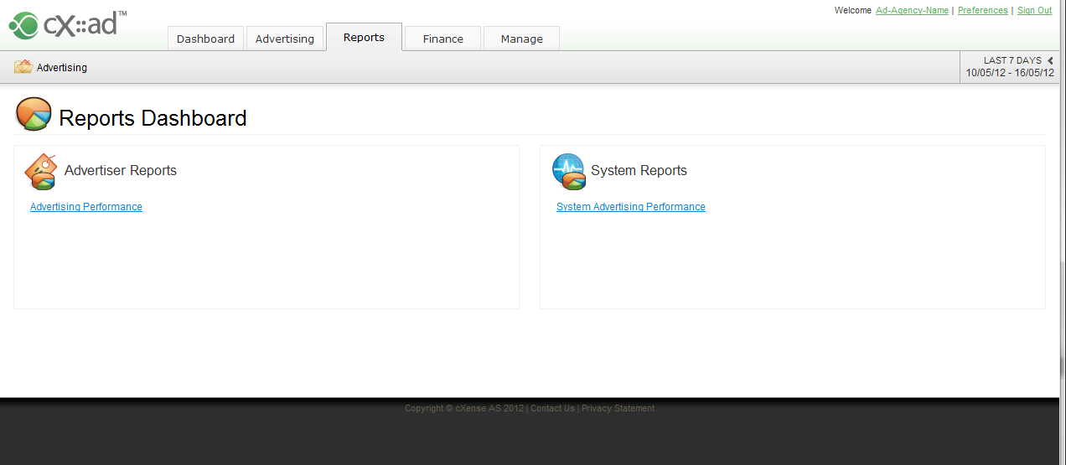
New Agency User
Agency User can view appropriate System Reports;
SAPr for Advertising Agency
SPPR for Publisher Agencies
along with the default Reports:
Advertising Performance
Publishing Performance

Slide 8
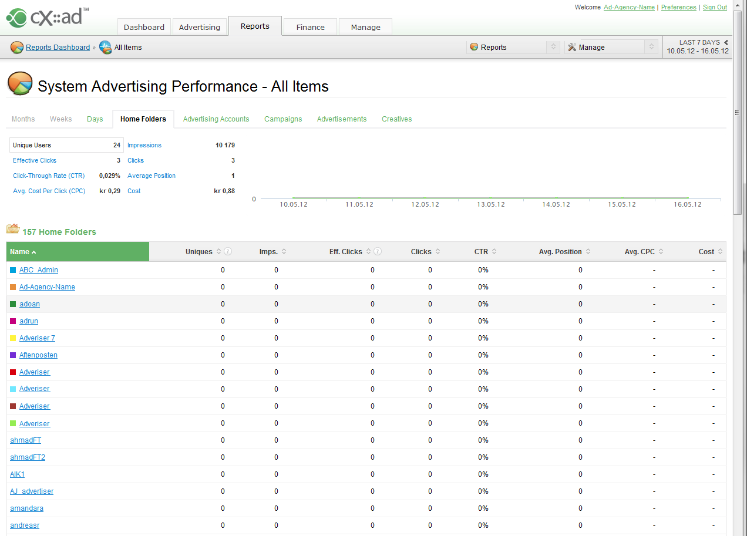
New Agency User
Provides aggregates for entire ‘sub network’ of users the Agency has created
SAPr (or SPPR for Publisher Agencies) shows all sub Advertisers / Sub Networks.

Slide 9
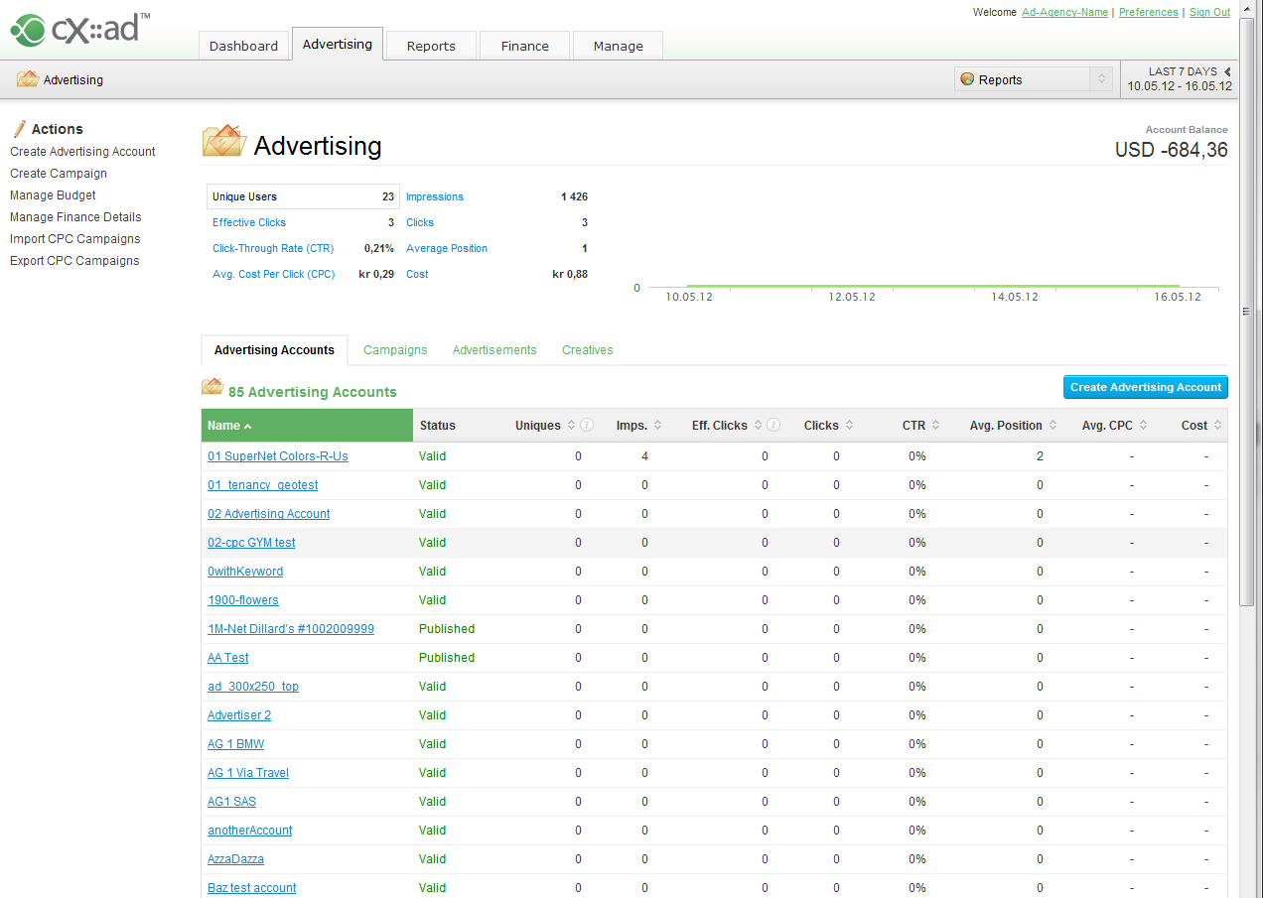
New Agency User
Agency can advertise and do direct sales on behalf of advertisers.
Agency User can invite additional users to assist in direct sales management (full folder access), or invite their clients (restricted folder access) as:
Report views only (Advertiser Analyst)
Read only Campaign view : (Full service)
Restricted Campaign Management (Self Service Advertiser)
Campaign Management : (Account Manager)

Slide 10
Further Notes
Agency Users
Must have at least one ‘Account Manager Role’ (Advertising &/or Publishing)
Can ‘Manage Users’ & Masquerade (Temporary Folder Access)
Cannot access their sub network Accounts /Campaigns directly
Cannot view any Data extracts (and therefore financial account data - with the exception of any data present in their System (Network) Reports
Can only see financial Data for CPM & CPC if configured via column visibility to do so
Brokers cannot see the aggregate of the Agency’s network in their SAPr, until delivery of CXAD-2257 (Stacked view within SAPr & SPPr reports).
Broker will continue to see the Agency’s direct Advertising/ Publishing (by viewing SAPr and the ‘agencyName _homefolder’ item) before and after CXAD-2257.
Further information regarding the Agency Role can be found on the wiki:
https://wiki.cxense.com/display/cust/User+Roles

